Slide 1
EuropEAN IDENTITY II

Slide 2
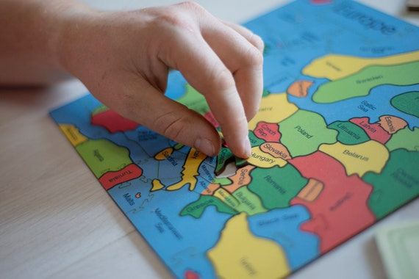
BUILDING EUROPEAN IDENTITY: WHO ARE “WE”?
https://youtu.be/p9hhXLho_94?si=eCjLLKsWq1bI7Ino

Slide 3
DECLARATION OF EUROPEAN IDENTITY, 1973
The 1973 Declaration on European Identity marked an important step in defining not just political cooperation, but the shared values that would underpin the European project. Adopted by the member states of the European Communities, the declaration emphasized principles such as democracy, the rule of law, social justice, and respect for human rights. These values were presented as the common foundation uniting diverse nations, highlighting that European integration was not only about economic collaboration but also about a collective commitment to freedom, equality, and the dignity of the individual.
Beyond internal cohesion, the declaration also projected these values onto the global stage, asserting that Europe should play a responsible and ethical role in international affairs. In the context of the Cold War, this meant distinguishing itself through its dedication to peace, cooperation, and multilateralism. There were also dictatorships in Europe (for example, Spain).

Slide 4
THE “EUROPE OF VALUES”
European identity is an evolving, multifaceted concept rather than a fixed, singular identity, bridging national, regional, and global identities. It is defined by shared values like democracy, human rights, and freedom, rather than just geography, often coexisting alongside strong national identities. This identity is fostered through EU policies, shared history, and cross-border experiences

Slide 5
Key components of European identity (WHAT)
Shared Values: A commitment to democracy, human dignity, equality, and the rule of law.
"United in Diversity": The EU motto reflects that European identity does not erase local cultures but exists alongside them, embracing diversity.
Historical & Cultural Foundations: Rooted in shared historical periods such as the Renaissance and Enlightenment, which emphasized reason and progress.
Cross-Border Experience: Increased mobility, such as the Erasmus student program, tourism, and working in other countries, reinforces a feeling of being Europea

Slide 6
SYMBOLS AND INSTITUTIONS (HOW)
To give concrete form to this abstract concept, the EU has created tangible elements that reinforce the sense of belonging:
European Citizenship: Introduced in 1992 (Maastricht Treaty), it grants rights such as freedom of movement and the right to vote in European elections. Common policies and solidarity (for example, COVID)
Common Symbols: The Euro, the blue flag with stars, the anthem (Ode to Joy), and Europe Day (May 9).
Mobility Programs: Initiatives such as the Erasmus+ program are considered fundamental drivers for young people to experience "Europeanness" firsthand.
Other cultural exchange: Media, sport, food exchange, arts, Eurovision….

Slide 7
Key DRIVERS AND CHALLENGES
The European Union (EU): Acts as a primary driver for creating a common identity through symbols (flag, currency), policies, and economic integration.
Top-Down vs. Bottom-Up: It is a mixture of institutional efforts (top-down) and personal, lived experiences (bottom-up).
Challenges: The lack of a single, clear definition makes it difficult to grasp. Regional disparities, the "urban-rural" divide, and strong national identities can limit the reach of a unified identity.
Generational Shift: Younger generations are often more likely to feel a sense of European identity compared to older generations

Slide 8
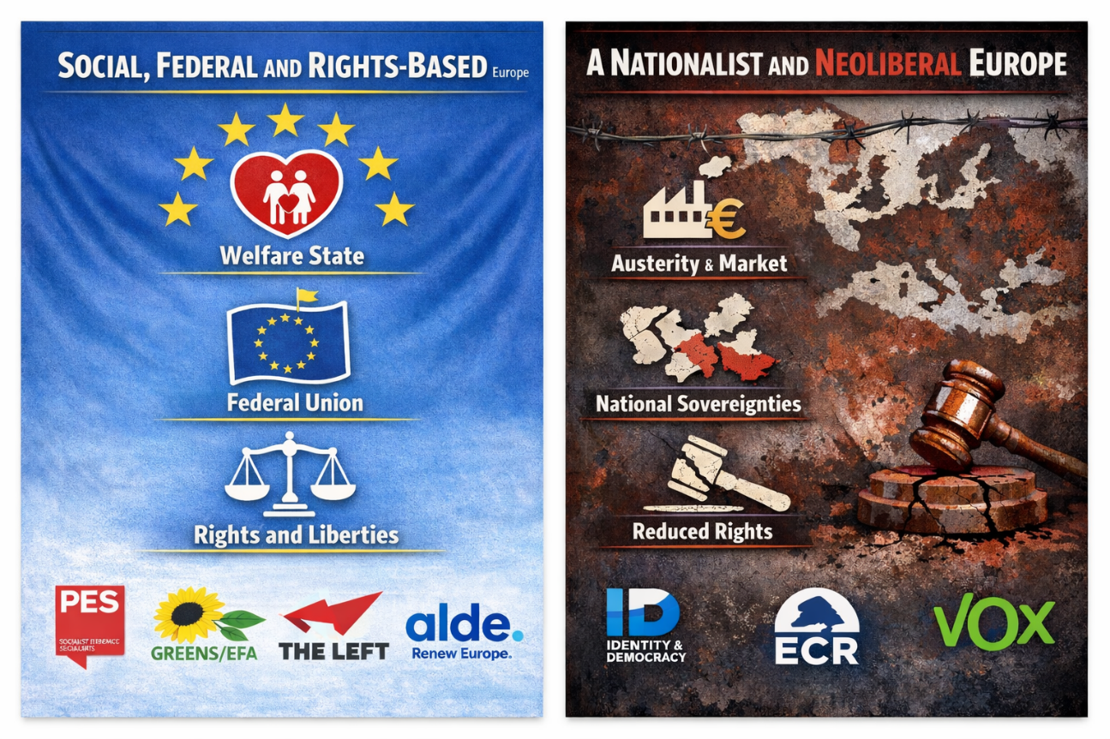
DIFFERENT VISIONS

Slide 9
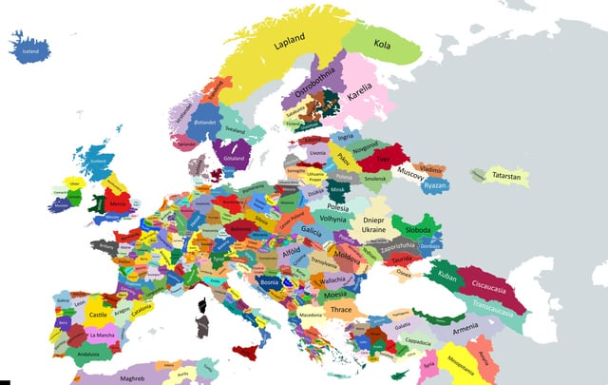
OTHER EUROPE(S)

